Slide 1


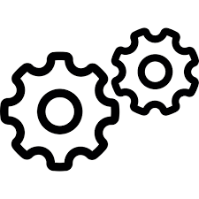
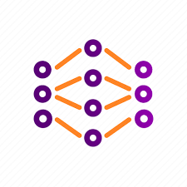




Gossip Federated Learning : zoom on a Grid Edge Device (V2)
Neighbouring Edge Devices
…
GED k Model weights
GED k Model weights
GED N Model weights
GED k Model weights
GED 1 Model weights
GED 2 Model weights
Aggregation applied to leaning model weights:
Spreading
Bonding
W$j$^{k}
W$j$^{k,1}
W$j$^{k,2}
W$j$^{k,n}
All GED learning models have the same structure.
W_{j+1}^{k}
Aggregation
Decay
Each GED manages model distribution and aggregation.
Model weights
W_{j}^{k}
Coordination platform
Mechanism generalised to any model : aggregation functions defined in learning model
Forecasting
service
Edge device
Learning
Model

